Slide 1
Instagram User Analytics

Slide 2
Project Description
This Instagram User Analytics project which is done on MySQL workbench involves analyzing user interactions and engagement with the app to provide valuable insights that can helps the business grow.
User analysis involves tracking how users engage with a digital product, such as a software application or a mobile app. The insights derived from this analysis can be used by various teams within the business. For example, the marketing team might use these insights to launch a new campaign, the product team might use them to decide on new features to build, and the development team might use them to improve the overall user experience.
This insights will help the product manager and the rest of the team make informed decisions about the future direction of the Instagram app. These findings could potentially influence the future development of one of the world's most popular social media platforms.

Slide 3
Approach
The approach towards this project is to analyze the data thoroughly and to understand business problem.
Tech-Stack Used
This project is done in MySQL Workbench 8.0 (Version 8.0.25) for creating queries. And the report is submitted in Power Point Presentation

Slide 4
A) Marketing Analysis

Slide 5
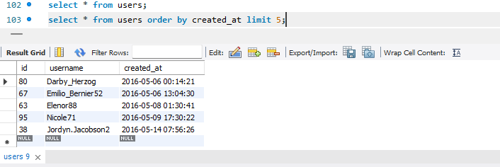
Loyal User Reward
The marketing team wants to reward the most loyal users, i.e., those who have been using the platform for the longest time.
Highlighting top 5 oldest users name of Instagram.

Slide 6
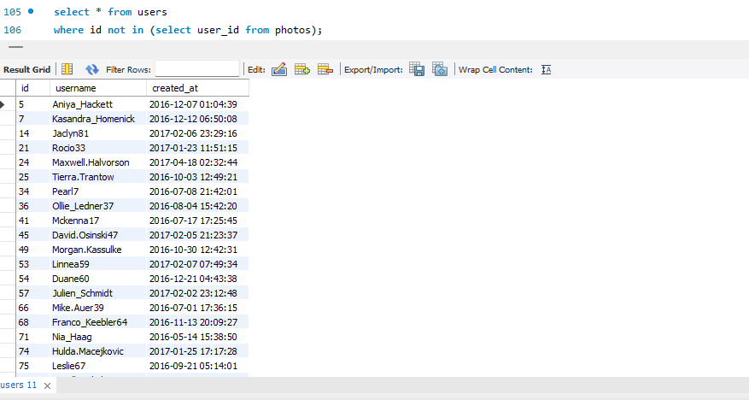
Inactive User Engagement
The team wants to encourage inactive users to start posting by sending them promotional emails.
Highlighting inactive users of Instagram.

Slide 7
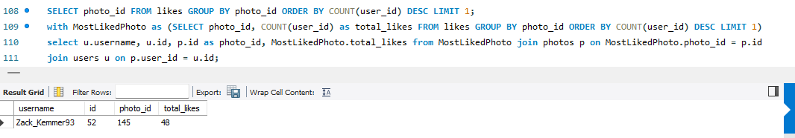
Contest Winner Declaration
The team has organized a contest where the user with the most likes on a single photo wins.
Highlighting the winner of the contest of Instagram.

Slide 8
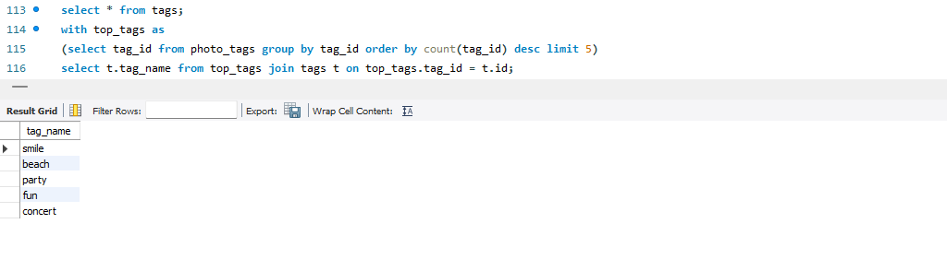
Hashtag Research
A partner brand wants to know the most popular hashtags to use in their posts to reach the most people.
Highlighting the top 5 most commonly used hashtags on the Instagram.

Slide 9
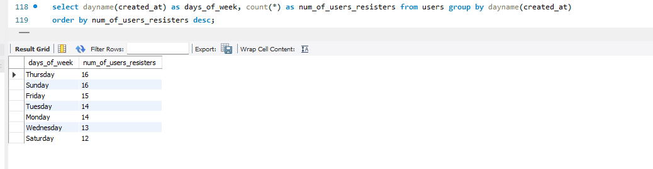
Ad Campaign Launch
The team wants to know the best day of the week to launch ads.
Highlighting the days of the week when most user resister on Instagram

Slide 10
B) Investor Metrics:

Slide 11
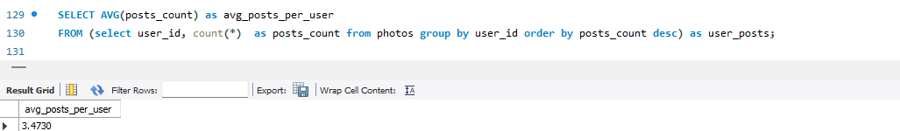
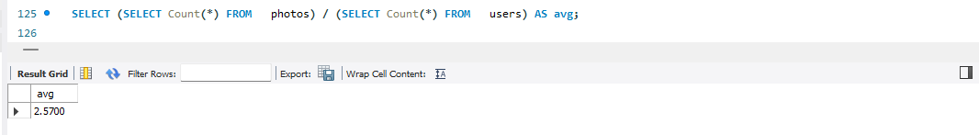
User Engagement
Investors want to know if users are still active and posting on Instagram or if they are making fewer posts.
Highlighting the average number of posts per user on Instagram.
The total number of photos on Instagram divided by the total number of users.

Slide 12
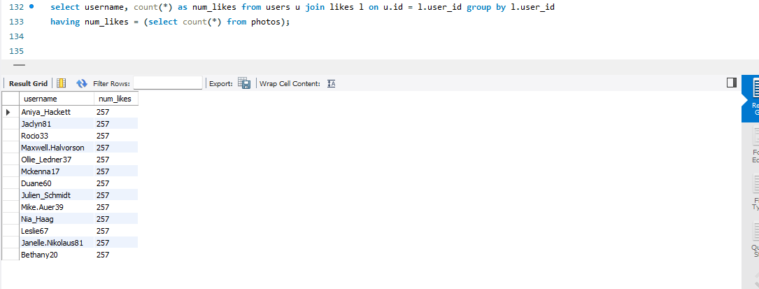
Bots & Fake Accounts
Investors want to know if the platform is crowded with fake and dummy accounts.
Highlighting fake users (potential bots) who have liked every single photo on the site, as this is not typically possible for a normal user.

Slide 13
Insights
From these project I get to know the following:
The top 5 oldest users of Instagram app
The list of inactive users of Instagram
The name of the winner for the most liked photo of Instagram contest
Top 5 commonly used hashtags of Instagram
The best day of the week to launch an ad campaign
Average number of post per user on Instagram
Countering the fake users of Instagram who liked every single photos of Instagram

Slide 14
Result
This project gave me an idea of how an analyst and business works on real time data. It gave me an understanding how analysis works and how to get insights from any given data.

Slide 15
THANK YOU

